Slide 1
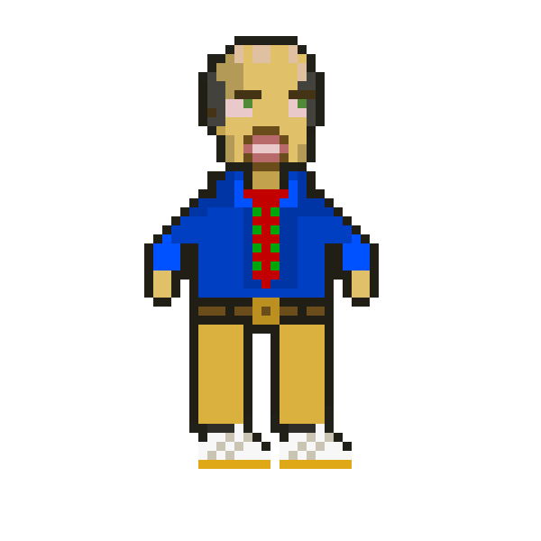
The Grand Adventure of Mr. Moreson
Brenden Daigle and Andre Mayard

Slide 2
The Idea
Settled on a 2D platformer
Used Unity for development and Piskel for animation
Brenden handled programming and Andre worked with design
Notes:
We were in-between game format ideas for a while, but eventually settled on a 2D platformer. We wanted to continue making games after the Congressional App Challenge, using Unity for development and Piskel for animation. We decided to use our previous knowledge to make the game, with Brenden handling programming and Andre doing design.

Slide 3
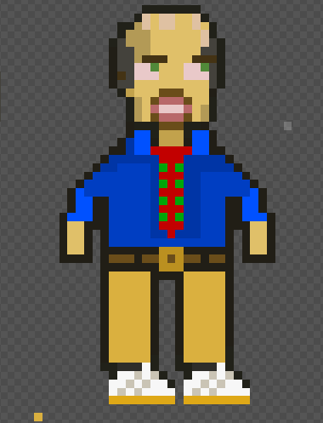
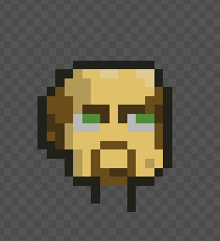
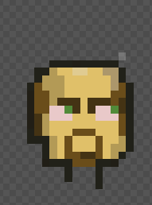
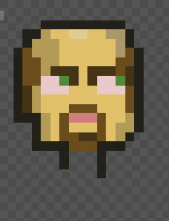
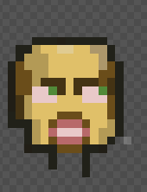
Creating Mr. Moreson
Mr. Thompson

Slide 4
Attack Animation
To start animating, I decided to start with the attack animation Mr. Moreson would do.
Just Hands to Scissors

Slide 5
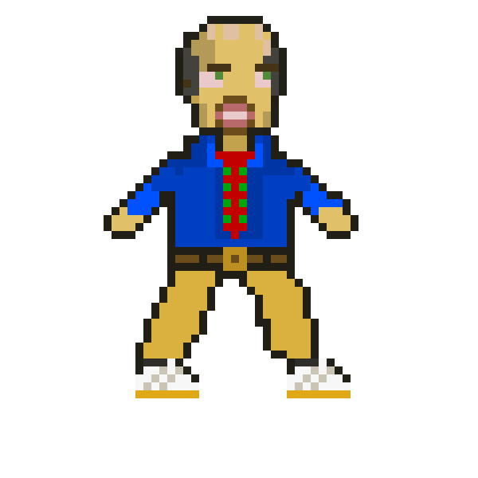
Running Animation
To continue, had to have movement
Crossing over legs
Notes:
dude this presentation was awesome

Slide 6
Idle Animation
Idle Animation for not doing anything
Increase Stuff Going on

Slide 7
Jumping Animation
Decided on keeping jump mechanics
Hard to translate into game

Slide 8
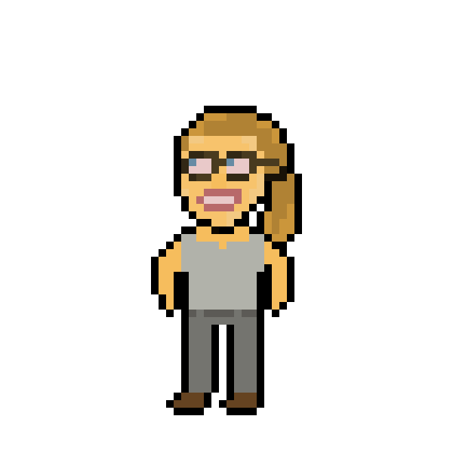
Other Characters
Tutorial Character - Mrs. Blossom
First Enemy - Computer Minion

Slide 9
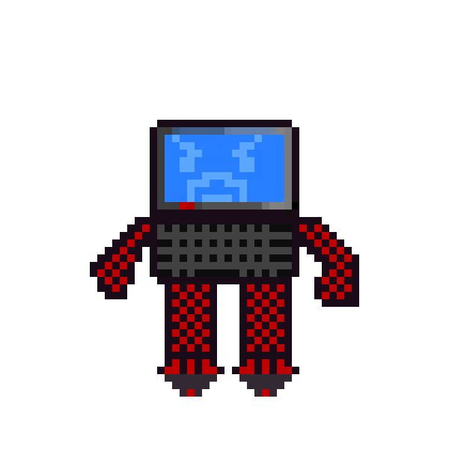
The Programming

Slide 10
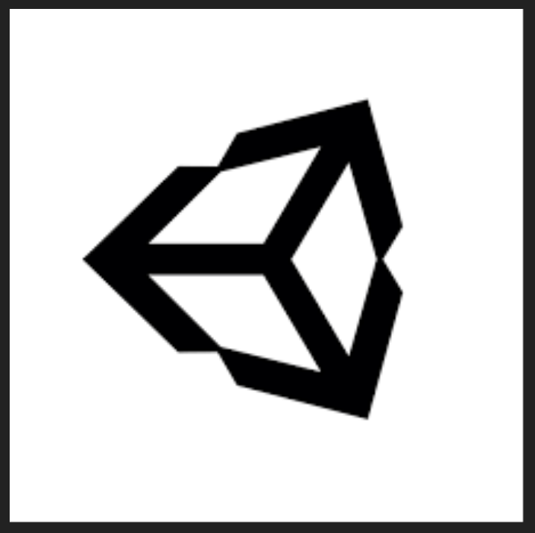
Game Development
Previous Knowledge
Implement Animation?
Character Movement for growth
Advanced Features

Slide 11
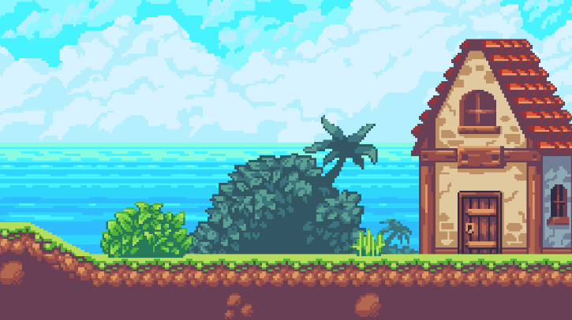
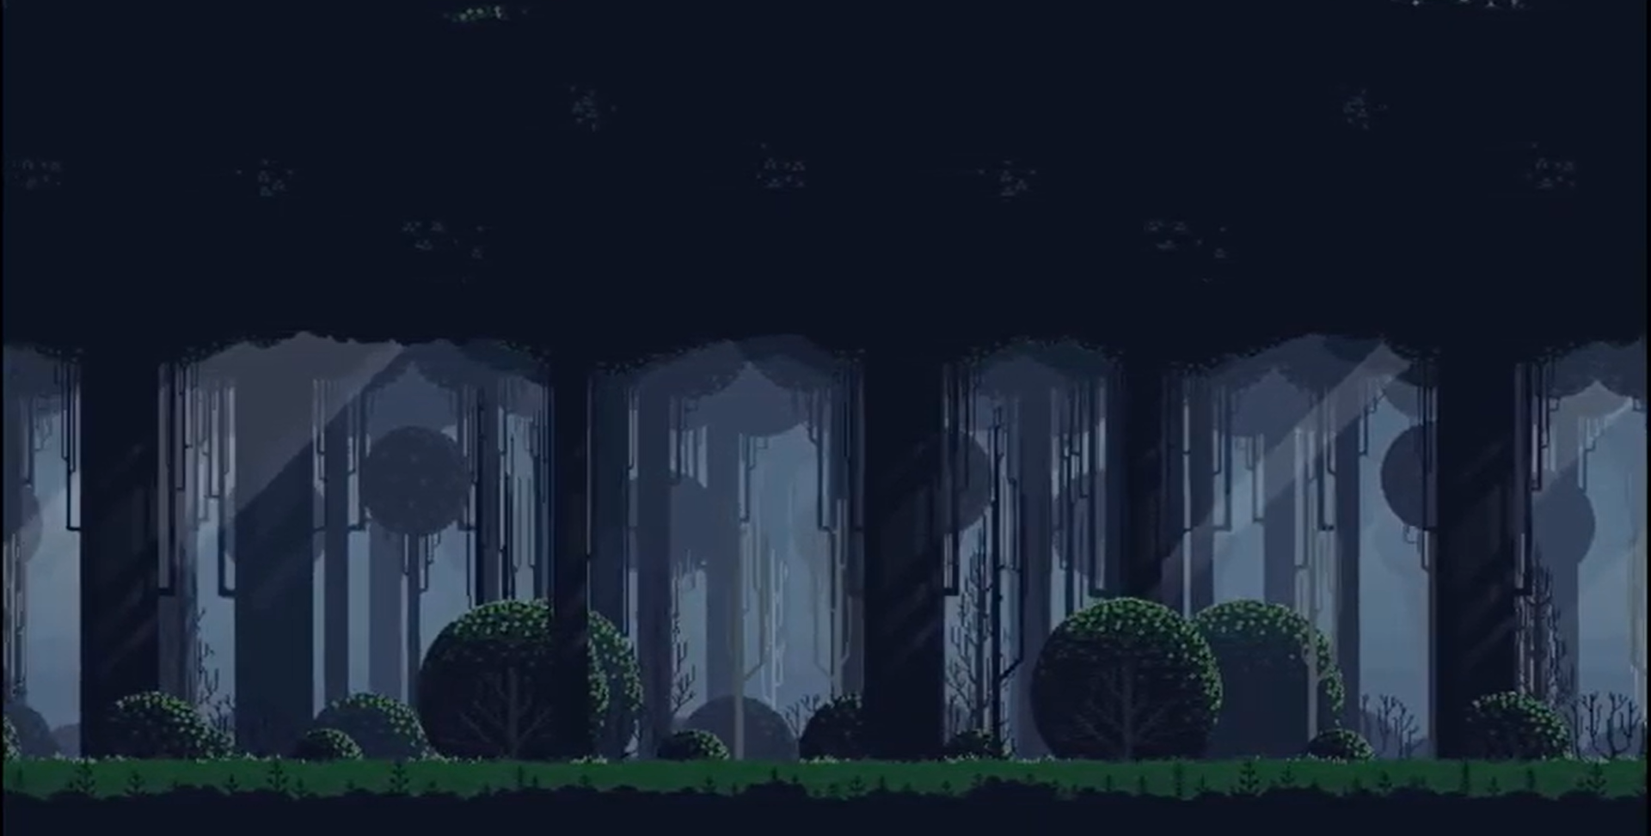
The Parallax Effect
Core Improvement
Realistic Perspective
One layer moves slower than the layer behind it
Notes:
parallax effect works by putting layers into a 2d scene

Slide 12
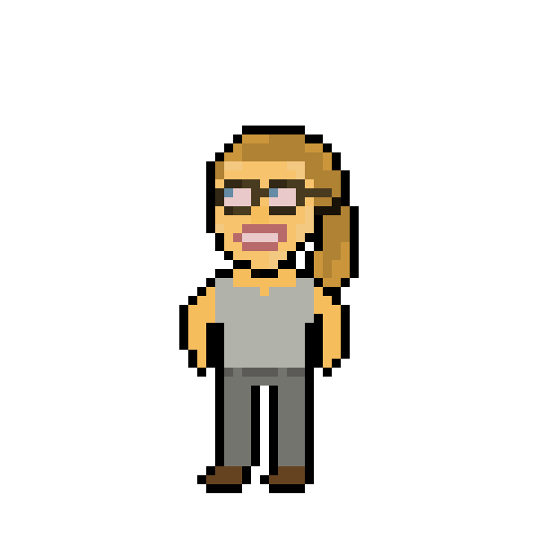
Demonstration

